Slide 1
Discussion 7: Asymptotic Analysis
Christine Zhou

Slide 2
Agenda
Announcements
Worksheet #3
Worksheet #1
Recursive Runtime
Worksheet #2

Slide 3
Announcements
Remember to commit frequently!
HW4 is due tomorrow
Proj1 is due this Friday!
Mid-semester survey coming up! Keep your eyes peeled
Advising sessions: You should have gotten an email from me, let me know if you haven’t!
Discussion survey: https://tinyurl.com/cz-disc7-fa18

Slide 4
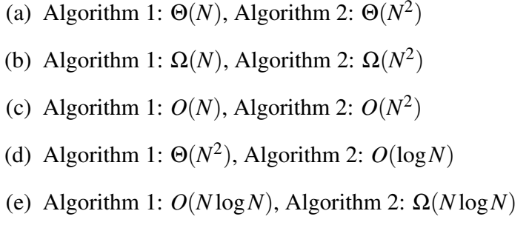
3 Hey you watchu gon do?
a) Algorithm 1
b) Neither
c) Neither
d) Algorithm 2
e) Neither

Slide 5
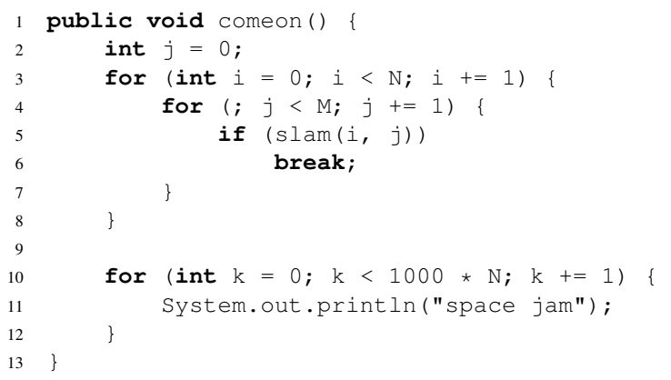
1 More Running Time

Slide 6
Practice Problem
public void hello(int n) {
if (n == 0) {
return;
} else {
for (int i = 0; i < 10000000; i += 1) {
System.out.println(“hello”);
}
hello(n-1);
}
}
Let’s draw the “work done” tree!

Slide 7
2 Recursive Running Time
public void andslam(int N) { if (N > 0) {
for (int i = 0; i < N; i += 1) {
System.out.println(“bigballer.jpg”);
}
andslam(N/2);
}
}

Slide 8
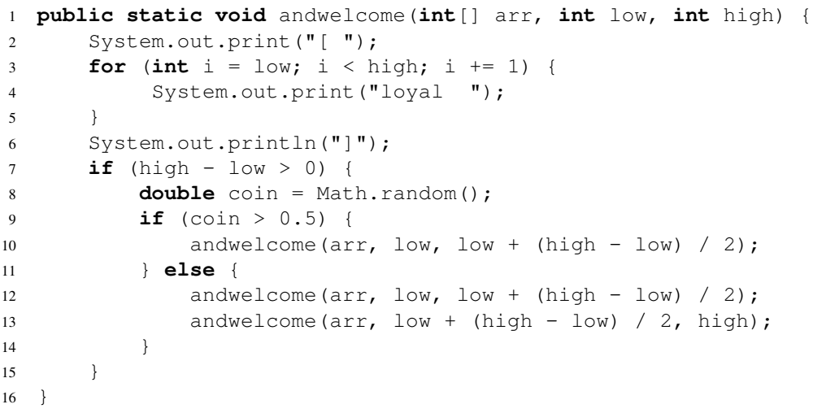
2 Recursive Running Time

Slide 9
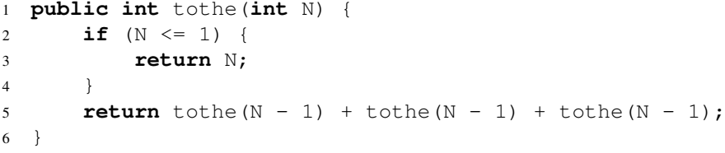
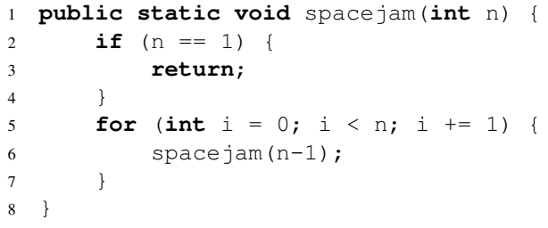
2 Recursive Running Time

Slide 10
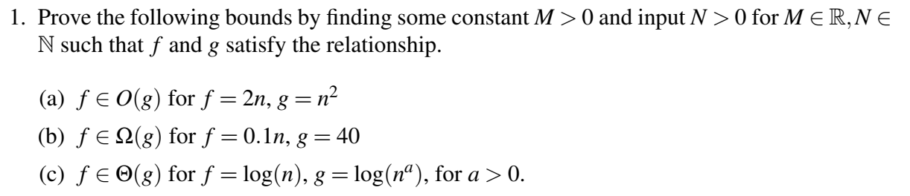




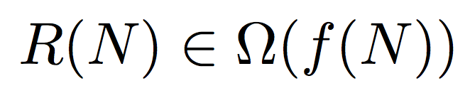
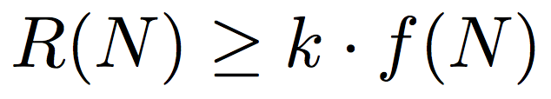
Big Ballin’ Bounds
Big Theta
Big O
Big Omega

Slide 11
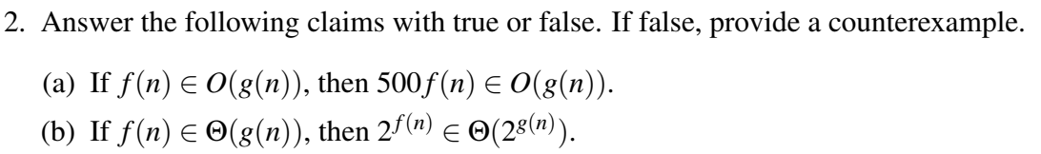
4 Big Ballin’ Bounds

